Slide 1
Number Formation Rhymes
Numbers 0-9

Slide 2











Slide 3

Around and round and round we go,
When we get home we have a ZERO.

Slide 4

Start at the top and down we run,
That’s the way we make a ONE.

Slide 5
Around the railway track and back,
TWO, TWO!

Slide 6

Around the tree and around the tree,
That’s the way we make a THREE.

Slide 7
Down and over and down some more,
That’s the way we make a FOUR.

Slide 8
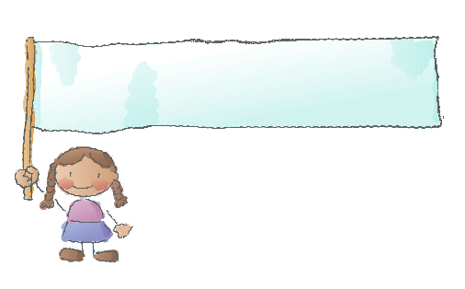
Down and around then a flag on high,
That’s the way we make a FIVE.

Slide 9
Down we go and make a loop,
Number SIX makes a hoop.

Slide 10
Across the sky and down from heaven,
That’s the way we make a SEVEN.

Slide 11
Make an ‘S’ and do not wait!
When it’s joined up you have an EIGHT

Slide 12
Make a loop and then a line,
That’s the way we make a NINE.

Slide 13
The End

